Slide 1
Examining the Relation Between Anxiety, Depression, and Psychological Flexibility in Female Bhutanese Refugees
Sheau-Yan Ho
University of Vermont
ACBS World Conference 12
June 20, 2014

Slide 2
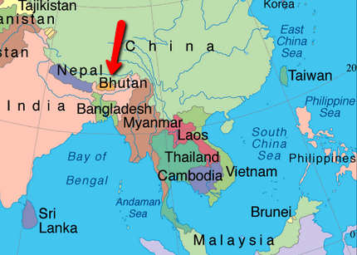
Notes:
Landlocked country in South Asia, bordered by China (north) and India
Known for being one of the happiest countries in the world
Has been termed “shangri-la” (equates to paradise)
However, many are not aware of the ethnic conflict that arose in the late 20th century

Slide 3
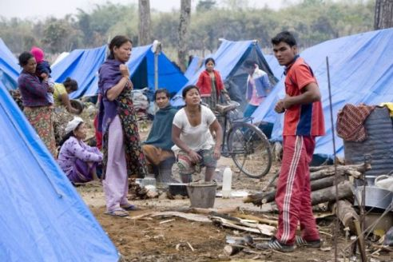
Bhutanese Refugees 101
Lhotsampas = “Southerners” of Nepal descent
Late 1980s: “One Nation, One People” policy
Over 100,000 Lhotsampas were persecuted and expelled
Resettled in refugee camps in Nepal for 18+ years
Notes:
As indicated by their name, Lhotsampas are Bhutanese people who lived in southernmost part of the country
Originally of Nepal descent
Coexisted peacefully with Drukpas/Buddhist elite (although some ethnic/cultural differences), subsisting as farmers, until late-1980s when the King imposed a “One Nation, One People” policy: conform to Drukpa norms (food they ate, how they dressed, the language they spoke)
Lhotsampas were persecuted/arrested/tortured, land/property were burned/confiscated by government, and over 100,000 Lhotsampas (close to 1/5 of the population) were expelled from the country
The Lhotsampas lived as refugees in camps (REFER TO PICTURE for poor conditions - plagued by disease, malnutrition, violence) for 18+ years; children born/raised in camps

Slide 4
Bhutanese Refugees 101
Over 75,000 Bhutanese refugees have since arrived in the U.S.
In Vermont alone, over 800 Bhutanese families have re-settled
Present with a host of psychological difficulties associated with post-migration stressors (e.g., employment, housing/food, language barrier, discrimination, lack of social support)
Notes:
Settled in refugee camps until other countries started to resettle refugees in (2007/08)

Slide 5
Adjustment Group Therapy Structure
Group started in August 2013
Facilitated by pre-doctoral clinicians
Conducted in English with Nepali interpreters
Weekly 2-hour meetings in community space
Open “drop-in” group format
Notes:
** NOT ACTUAL MEMBERS IN PHOTO **
Women sought psychological services from community clinic
-Growing need for female Bhutanese adults with depressive/anxiety symptoms dealing with post-migration stressors
Facilitated by pre-doctoral clinicians trained in ACT and cross-cultural work with refugees
Conducted in English, with the interpretive services of Nepali interpreters
Unique format: Weekly 2-hour meetings in community space; open “drop-in” group format

Slide 6
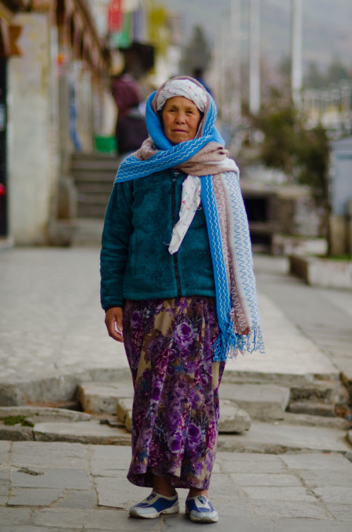
Group Structure: Demographics
Bhutanese women (N = 13)
M age = 45.54 yrs (SD = 9.05)
Marital status: 69% Married, 15% Widowed, 15% Single
Religion: 77% Hindu, 15% Christian, 8% Buddhist
Uneducated; unemployed or on disability
Torture survivors: 54%
M duration in U.S. = 2.67 yrs (SD = 1.37)
Notes:
To date, we have collected baseline and mid-treatment data on 13 women (hopefully group will continue to grow!)
-Mean age = 45.54 years (range 26-60)
-Marital status: 9/13 Married, 2/15 Widowed, 2/15 Single
-Religion: 8/13 Hindu, 2/13 Christian, 1/13 Buddhist
-12/13 are uneducated and illiterate; majority are also unemployed or on disability
-Approximately half of the women identify as torture survivors (i.e., she or family member was directly targeted/tortured by Bhutanese government)
-Relatively new to the US! mean duration in U.S. = 2.67 years (range 1-6)

Slide 7
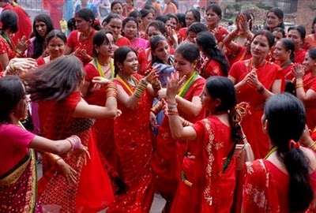
Group Therapy: Topics
ACT Framework
Goals of therapy
Acculturation
Access to resources
Coping skills
Values work
Living with chronic pain
Communication in healthy relationships
Notes:
Goals of therapy:
provide a safe space to gather and share experiences,
gain acceptance of emotional pain and struggles, (e.g., acculturation, chronic pain, relationships)
engage in actions consistent with personal/cultural values, thereby increasing psychological flexibility
Themes/topics discussed draw from ACT framework – gaining acceptance, being in the present moment and engaging in actions consistent with their cultural/personal values
1. Acculturation: discussion of cultural differences between Bhutan/Nepal and U.S. – weaved throughout sessions/various topics
2. Access to resources: transportation barrier, medical care system
3. Coping strategies: although yoga/meditation/mindfulness practice is very common among the Bhutanese community because the predominant practiced religion is Hinduism, and most of the women are well versed in mindfulness practice, the women often lead exercises – in line with goal to increase women’s sense of mastery/feelings of personal empowerment
4. Values work: discussion around wellbeing or “Ananda”
5. Living with chronic pain: somatization is highly prevalent among group members, somatic complaints appear to be highly linked to internalizing problems
6. Communication in healthy relationships: in line with goal to provide members with a safe place to gather and share their concerns with one another (issue of confidentiality has come up repeatedly)

Slide 8
Measures
Harvard Trauma Questionnaire
PTSD
Hopkins Symptom Checklist-25
Anxiety
Depression
Acceptance and Action Questionnaire – II
Psychological Flexibility
Notes:
Baseline depression/anxiety and PTSD symptoms.
The HSCL-25 and HTQ, well-validated measures in refugee populations, were administered prior to beginning group therapy to assess depression/anxiety and PTSD.
Mid-treatment psychological flexibility.
The 7-item AAQ-II was administered to assess psychological flexibility after six months of running “drop-in” group sessions (i.e., after a variable number of sessions per individual).
M number of sessions attended = 16.09, SD = 6.77

Slide 9
Descriptives & Correlations Between Study Variables
 | Variables | M (SD) | 2 | 3 | 4 | 5 | 6
1 | HSCL Anxiety | 3.07 (.51) | .56* | .83** | .63* | .67* | .13
2 | HSCL Depression | 3.19 (.52) | --- | .93** | .29 | .39 | .12
3 | HSCL Total | 3.14 (.46) |  | --- | .48 | .57 | .13
4 | HTQ DSM-IV PTSD | 2.72 (.46) |  |  | --- | .96** | .55
5 | HTQ PTSD Total | 2.68 (.40) |  |  |  | --- | .32
6 | AAQ Total | 35.00 (10.28) |  |  |  |  | ---
HSCL = Hopkins Symptom Checklist (Depression, Anxiety)
HTQ = Harvard Trauma Questionnaire (PTSD)
AAQ = Acceptance and Action Questionnaire (Psychological Flexibility)
*p < .05, **p < .01
Notes:
Higher scores indicate GREATER symptom severity:
HSCL – divided into anxiety (13 items), depression (12 items) subscales, and total score
HTQ – divided into DSM-IV PTSD score (16 items) and PTSD total score (additional 15 items associated with PTSD, e.g., depressive symptoms, dissociation)
Higher scores indicate LOWER psychological flexibility
AAQ
Clinically elevated scores on the HSCL/HTQ: indicate severe levels of depression, anxiety, PTSD
13/13 HSCL
7/11 HTQ
Baseline scores of depression, anxiety, and PTSD were not significantly correlated with mid-treatment scores of psychological flexibility.
However, we did observe sizeable correlations between measures of post-traumatic stress and psychological flexibility (.32 and .55).

Slide 10
Simple Regression Analyses Predicting Psychological Flexibility in ACT Group
Variables | ΔR² | β | p
Number of sessions attended | .07 | .26 | .45
HSCL Anxiety | .02 | .13 | .70
HSCL Depression | .02 | .12 | .72
HSCL Total | .02 | .13 | .70
HTQ DSM-IV PTSD | .30 | .55 | .13
HTQ PTSD Total | .10 | .32 | .40
Notes:
M number of sessions attended = 16.09, SD = 6.77
Depression, anxiety, PTSD, and number of sessions attended were not significantly associated with psychological flexibility following group format ACT treatment.
However, I do want to point out the DSM-IV PTSD subscale regression. We can see a trend toward significance indicating that higher levels of baseline PTSD symptoms (per DSM-IV) were associated with lower levels of psychological flexibility at mid-treatment. Moreover, as indicated in the table, these symptoms accounted for 30% of the variance in psychological flexibility. Given that these analyses were run with N = 11, this is a substantial trend that we would expect to approach significance in a larger sample size.

Slide 11
Summary
First study to examine psychological flexibility as a process mechanism in a group format ACT intervention for Bhutanese refugees
Trend toward significance indicating that higher levels of baseline post-traumatic stress symptoms were associated with lower levels of psychological flexibility at mid-treatment.
Notes:
Baseline depression, anxiety, and PTSD symptom severity were not significantly related to psychological flexibility. However, there were sizeable correlations between PTSD and psychological flexibility, which may approach significance in a larger sample.
There was also a trend toward significance indicating that higher levels of PTS symptoms were associated with lower levels of psychological flexibility at mid-treatment.
One potential explanation for this trend is that anxiety and depression may be related to post-migration stressors that are targeted in the group intervention, whereas past traumas associated with PTSD symptoms are not specifically targeted.
Alternatively, symptom severity may not be associated with psychological flexibility, given that ACT does not focus directly on symptom reduction.

Slide 12
Future Directions
Growing sample size
Multiple time points
Examine other potential therapeutic processes
Notes:
Limitations: It is important to note that these are preliminary data based on a small sample size. Moreover, this study lacked a true longitudinal design in which we could assess change in psychological flexibility or other symptoms over time.
Further study of group therapeutic processes is needed in a larger female Bhutanese sample and with the addition of multiple time points.
Results suggest some interesting directions for future study, including the effect of past trauma on psychological flexibility and change in flexibility over time in group therapy that focuses on acceptance and actions consistent with values.
Future studies should examine changes in psychological flexibility as well as other potential therapeutic processes (emotional processing, social support, functional improvements) over the course of continued group format ACT treatment in this population as well as other refugee groups.
Other measures:
DERS: emotion dysregulation (non-acceptance of emotional responses subscale)
COPE: emotional processing, emotional expression, seeking social support
SF-12

Slide 13
Questions? Contact: sho@uvm.edu
Notes:
ABSTRACT: Group therapy models for refugees and torture survivors point to the importance of multi-systemic and multi-component treatment, yet few studies have examined the therapeutic processes by which group therapy operates in this population. In the present study, Bhutanese females seeking psychological services from a community clinic were treated in an open adjustment group (N = 10). Group treatment utilized an acceptance and commitment therapy (ACT) framework to address psychological wellbeing. Participants were assessed for symptoms of anxiety, depression, and posttraumatic stress disorder at baseline using the Hopkins Symptom Checklist and Harvard Trauma Questionnaire. Mid-treatment measurements included the Acceptance and Action Questionnaire. Here, we present descriptive data on how symptoms of anxiety and depression relate to and predict mid-treatment measures of acceptance and willingness to pursue valued experience. The findings of this study will begin to elucidate the mechanisms that explain therapeutic change over time in a Bhutanese adjustment group. Results also hold broader implications that may improve mental health treatment of refugees and torture survivors to address a range of presenting mental health problems.

